Slide 1
Introducing Security to SQL Server - for the rest of us.
Demystifying Encryption

Slide 2
Thank you to our sponsors:

Slide 3
Evaluations:

Slide 4

Who Is This Session For?
Me
…not so much the wookie

Slide 5
What We Will Cover?
An Introduction To Encryption
And Introduction To The 5 Types Of SQL Encryption
Object Encryption
Backup Encryption
Transparent Data Encryption (TDE)
Always Encrypted
Connection Encryption
Notes:
For each one we’ll talk about what editions are needed and versions.
A Demo of each one.

Slide 6
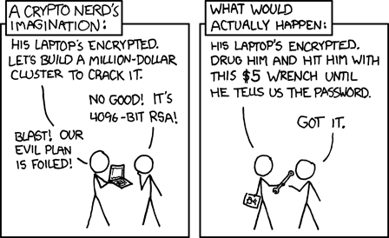

The Scary Slide
Notes:
List a few big breaches and what it cost the company.
https://www.toptenz.net/10-most-expensive-data-breaches-and-a-simple-trick-to-protect-your-website.php
https://www.cryptopia.co.nz/
Promise Encryption solves the problem.
BUT….
Show the cartoon
BUT…
General Data Protection Regulation(GDPR) says a bunch of things about what you can and can’t do. You can only collect data if there’s a business need to do it. can impose fines on data breaches, and those fines get bigger if you can be shown to have not made a reasonable effort to protect your data. ($10million Euro r 2% of worldwide revenue(not profit) - whichever is higher. Double if shown to be egregious violation. There needs to be a real verifiable effort.)
Data Breaches are bad - It’s your job to stop them. If you don’t you might get lucky and lose your job, but you might get unlucky and your company goes out of business and all your mates lose their job too.
So here’s where Encryption comes in.

Slide 7
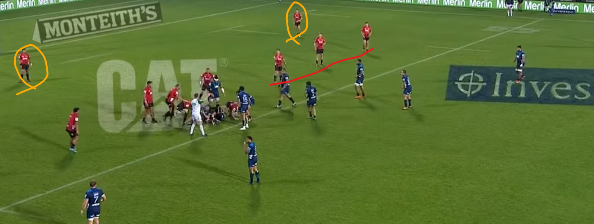
Defense In Depth
Notes:
Encryption is only part of a security plan - Rugby Analogy
Servers in an locked room
Data not being downloaded and stored in excel
Passwords reset
Data not available
Etc
Etc

Slide 8
What is Encryption?
“Encryption is the process of encoding a message or information in such a way that only authorized parties can access it and those who are not authorized cannot... The intended information or message, referred to as plaintext, is encrypted using an encryption algorithm – a cipher – generating ciphertext that can be read only if decrypted.“
Wikipedia\Encryption
Notes:
In other words it’s the reversible obsfuscation of data.
Reversibility depends on a key
Only Part of your overall security plan. - Defense In Depth.

Slide 9
Object Encryption
Object Encryption(Not Really)
Available in all versions/editions of SQL Server
Just add WITH ENCRYPTION to object definition
Not really Encrypted - just Obfuscated
Can be decrypted by a malicious user with a small amount of effort
Notes:
https://sqlity.net/en/1617/decrypting-encrypted-database-objects/
A known plaintext attack against an encryption algorithm can be use when you have the ability to get you hand on a particular data set in the encrypted and the unencrypted form.

Slide 10
Object Encryption Demo

Slide 11
Backup Encryption
Introduced in SQL Server 2014
Available in Standard or Enterprise Edition
Encrypts Native Backup files
Based on a certificate stored securely within the SQL Server engine

Slide 12
Backup Encryption Demo

Slide 13
Transparent Data Encryption (TDE)
Introduced in SQL 2008 Enterprise Edition
Still Enterprise Edition Only
Also based on certificate within the SQL Engine
Encrypts at rest
MDF, NDF, LDF files only
Server-side Encryption and Decryption

Slide 14
Transparent Data Encryption Demo

Slide 15
Transparent Data Encryption (TDE) - Stuff We Learned
Encrypting any one database with TDE also encrypts TempDB
Restoring Backups requires the certificate
Can use TDE AND Backup Encryption
No blocking while encrypting
Best Practice is use separate certificates

Slide 16
Always Encrypted\Column Encryption
Introduced in SQL 2016
Enterprise Only before SP1
Standard Edition with release of SP1
Encrypts Only Specific Columns
Application Side Encryption and Decryption
DBA can’t see data!
Certificate is installed on the application server
Notes:
Application accepts input and encrypts them - then sends a big VARBINARY to SQL - SQL just thinks there’s a bunch of varbinaries in the database.
Can’t do via TSQL - must be Management Studio or application
-Deterministic(Same values are encrypted to the same values)
-Randomized - everything is encrypted.

Slide 17
Always Encrypted Demo

Slide 18
Always Encrypted
Column Limitations - Constraints and Data Types
Deterministic vs Non-Deterministic
Blocking Operation while Encryption takes place
Certificate not managed by SQL Server

Slide 19
Connection Encryption
Available in all versions/editions of SQL Server
Encrypts data in flight
Client and server side Encryption/Decryption
Uses Secure Socket Layer (SSL)
Notes:
https://docs.microsoft.com/en-us/sql/database-engine/configure-windows/enable-encrypted-connections-to-the-database-engine?view=sql-server-2017
https://msdn.microsoft.com/en-GB/library/mt163865.aspx?f=255&MSPPError=-2147217396

Slide 20
Connection Encryption Demo
Notes:
Force Encryption
https://docs.microsoft.com/en-us/sql/database-engine/configure-windows/enable-encrypted-connections-to-the-database-engine?view=sql-server-2017

Slide 21
Certificates Maintenance
Back Up All Your Certificates
Keep them where they are Protected and Available(Safe and Secure)
Do Not Lose Your Certificates!
Remember that if you lose the certificate you lose your data!

Slide 22
Questions

